Slide 1

Experimental and Numerical Characterization of Pristine Plasmas
Kamran Shojaei
March 8th , 2021

Slide 2
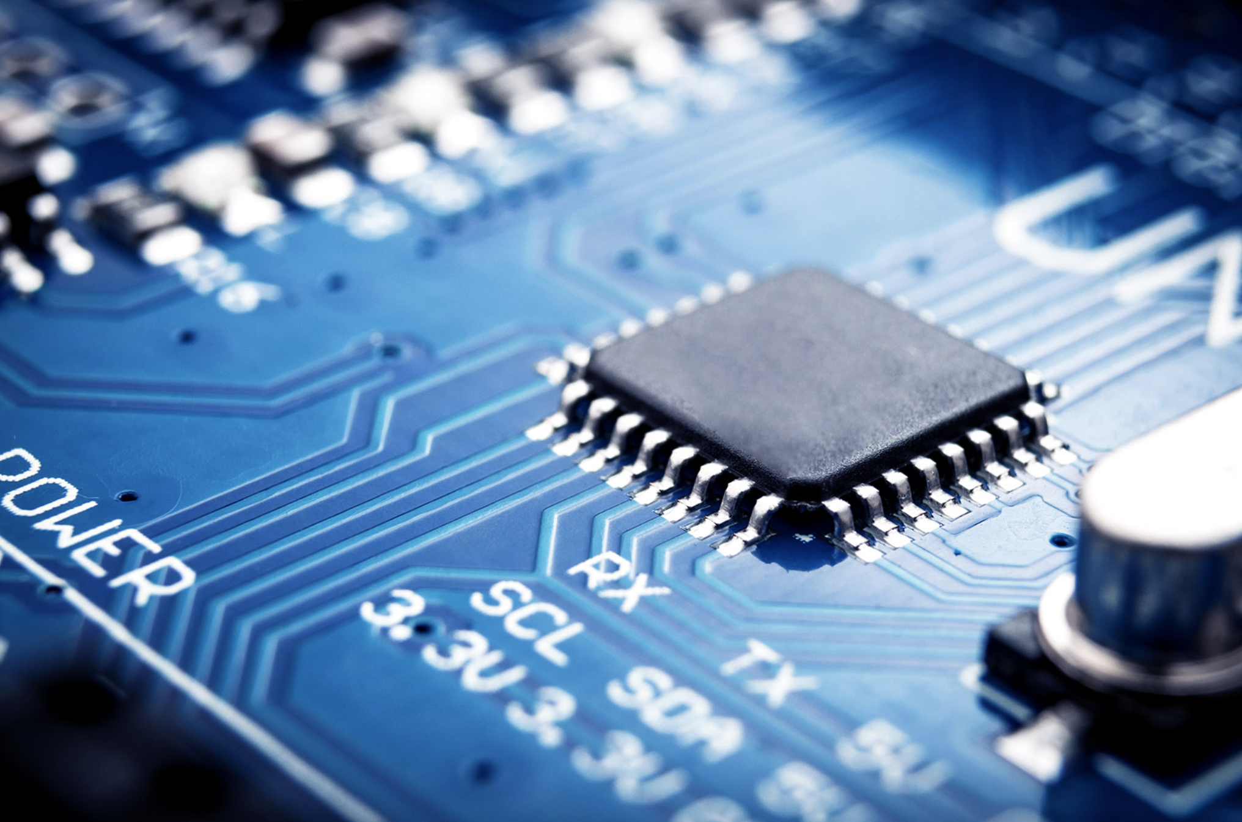
Plasmas:
Applications of Plasmas:
The semiconductor industry
Material Synthesis

Slide 3
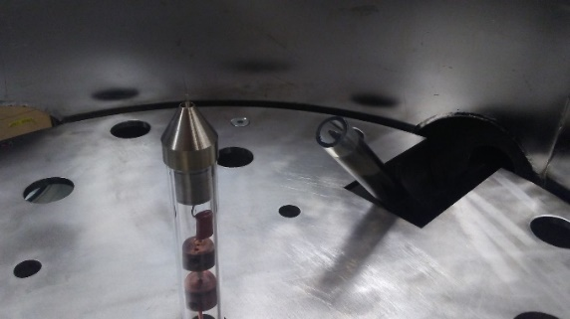
Langmuir Probes: Motivation
Much of the knowledge on gas discharges has come from experimental approaches using Langmuir probes and spectroscopic techniques
Langmuir probe

Slide 4
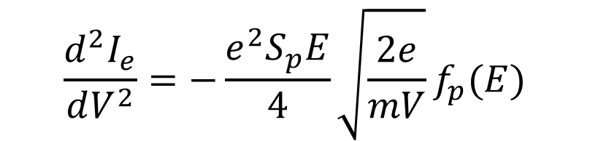
Langmuir Probes
Electric probes have been used as early as the beginning of the 20th century
Truly came into fruition with Langmuir’s work
Further developed by Druyvestyn
From Druyvestyn, we are able to directly determine the electron-energy distribution function (EEDF, F(E)), and thus probability function (EEPF, f_{p}(E)), from the second derivative of the probe current.
$$\frac{d^{2}I_{e}}{dV^{2}}=−\frac{e^{2}S_{p}E}{4}\sqrt{\frac{2e}{mV}}f_{p}(E)$$
Mott-Smith H M and Langmuir I 1926 Phys. Rev. 28 727 M. J. Druyvesteyn, Z. Phys, vol. 64, pp. 781–798, 1930

Slide 5
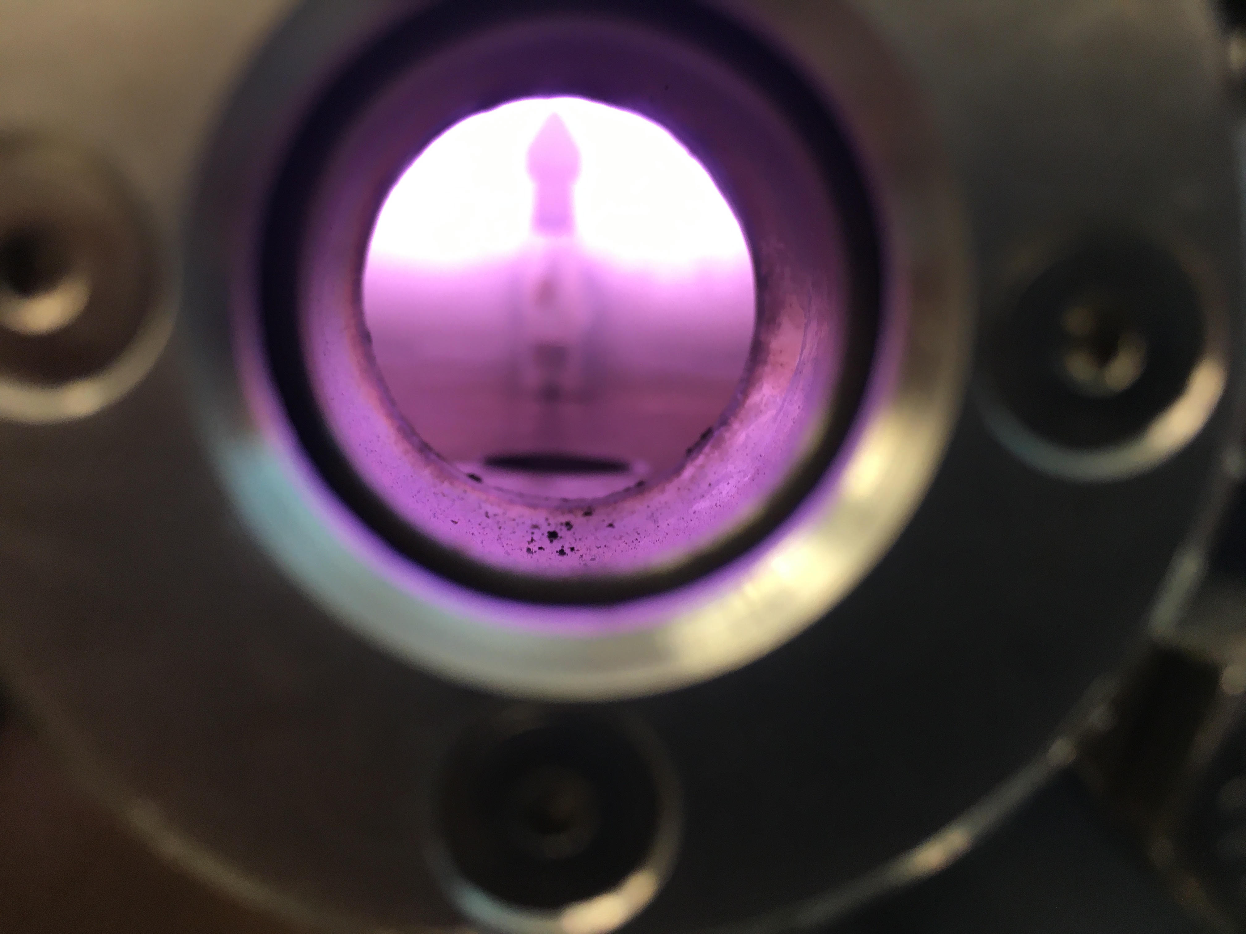
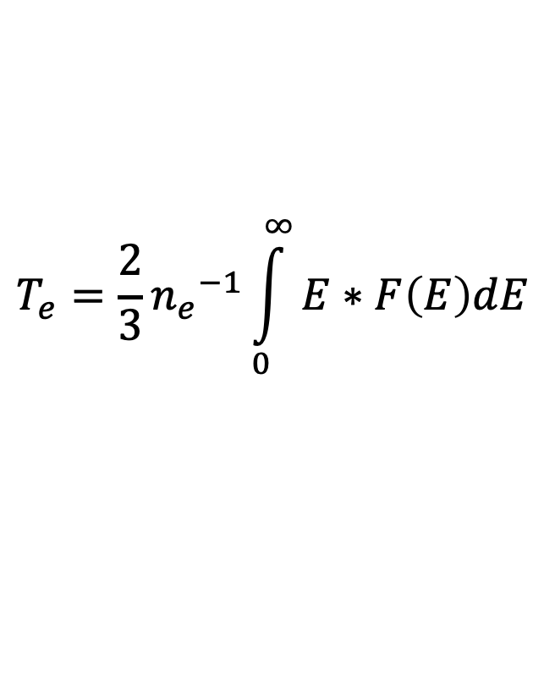
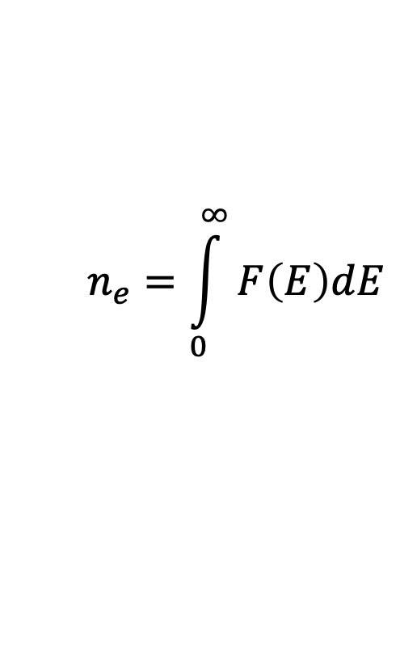
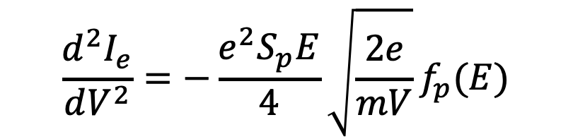
Langmuir Probes
From F(E) or f_{p}(E), we can determine electron density and temperature
$$\frac{d^{2}I_{e}}{dV^{2}}=−\frac{e^{2}S_{p}E}{4}\sqrt{\frac{2e}{mV}}f_{p}(E)$$
$$n_{e}=\int_{0}^{∞}{F\left(E\right)dE}$$
$$T_{e}=\frac{2}{3}{n_{e}}^{−1}\int_{0}^{∞}{E∗F\left(E\right)dE}$$
Mott-Smith H M and Langmuir I 1926 Phys. Rev. 28 727 M. J. Druyvesteyn, Z. Phys, vol. 64, pp. 781–798, 1930
Lieberman M A and Lichtenberg A J 2005 Principles of Plasma Discharges and Materials Processing (New York: Wiley)

Slide 6
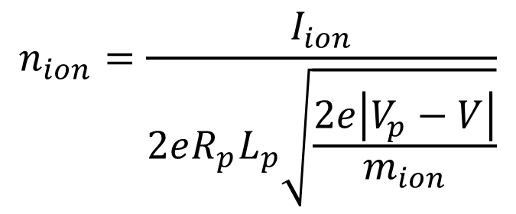
Langmuir Probes
Finally, the last important parameter, the ion density, can be obtained directly from the probe I-V characteristic
$$n_{ion}=\frac{I_{ion}}{2eR_{p}L_{p}\sqrt{\frac{2e\left|V_{p}−V\right|}{m_{ion}}}}$$
V_{plasma}
V_{floaing}
Mott-Smith H M and Langmuir I 1926 Phys. Rev. 28 727 M. J. Druyvesteyn, Z. Phys, vol. 64, pp. 781–798, 1930
Lieberman M A and Lichtenberg A J 2005 Principles of Plasma Discharges and Materials Processing (New York: Wiley)

Slide 7
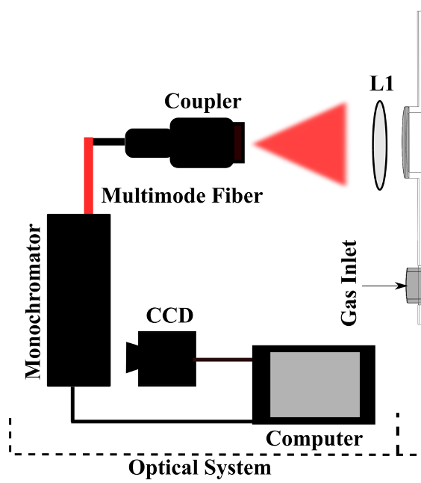
Spectroscopy

Slide 8
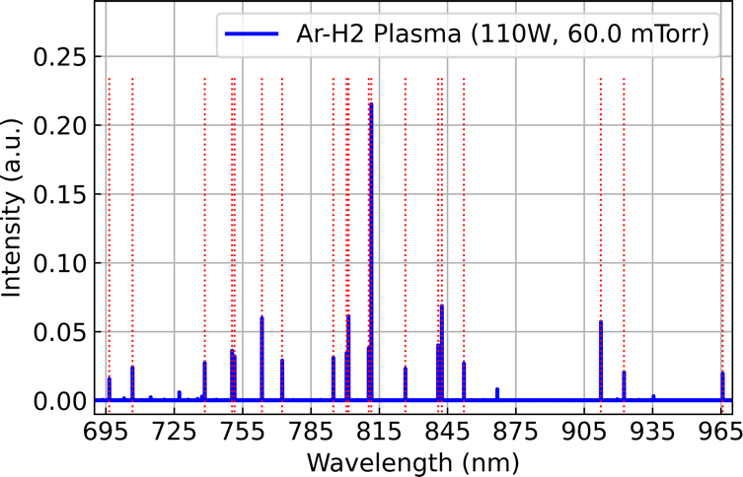
Spectroscopy

Slide 9
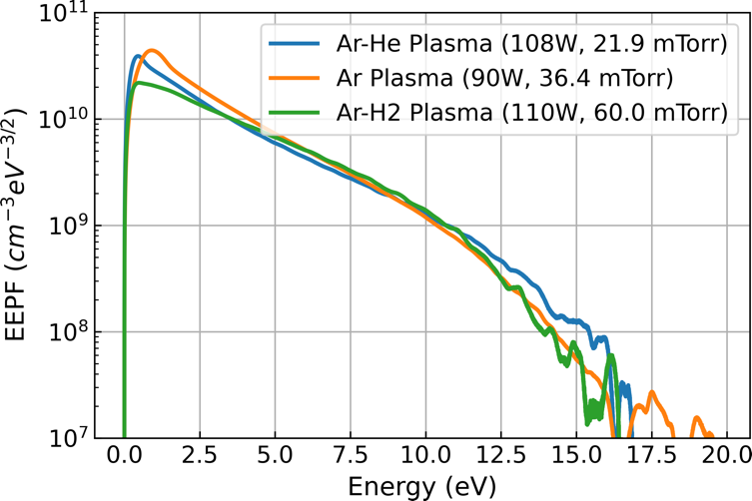
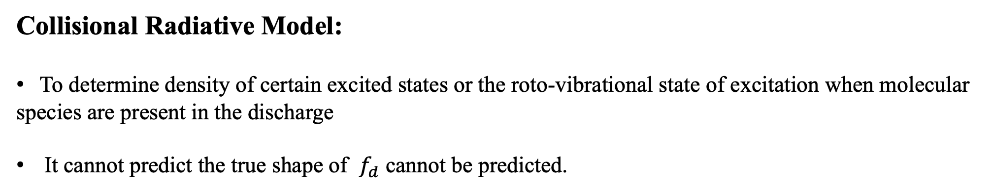
Models
Collisional Radiative Model:
To determine density of certain excited states or the roto-vibrational state of excitation when molecular
species are present in the discharge
It cannot predict the true shape of $f_{d}$ cannot be predicted.

Slide 10
Machine Learning: Motivation
Why should we use machine learning for diagnostics of non-thermal plasmas?
Langmuir probe as a characterization technique is non-trivial to set-up and utilize.
It’s desirable to use simpler and more accessible tools for the characterization of EEPF.
Physics-based models fall short

Slide 11
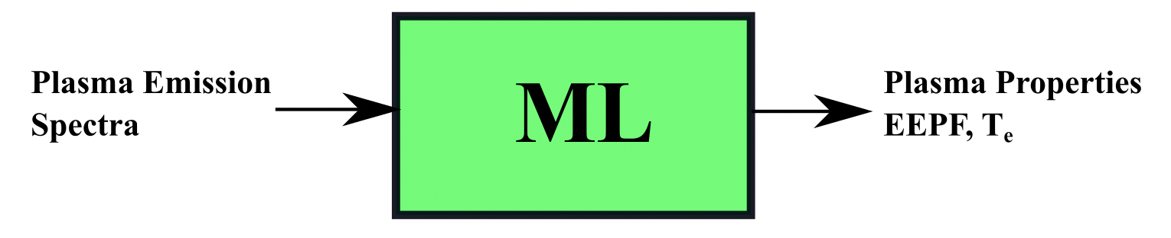
Machine Learning: Motivation
Why should we use machine learning for diagnostics of non-thermal plasmas?
To bypass the complex physics!
Create machine learning models for those who can only perform plasma spectroscopy to predict plasma properties from plasma emission spectra especially electron energy probability function.

Slide 12
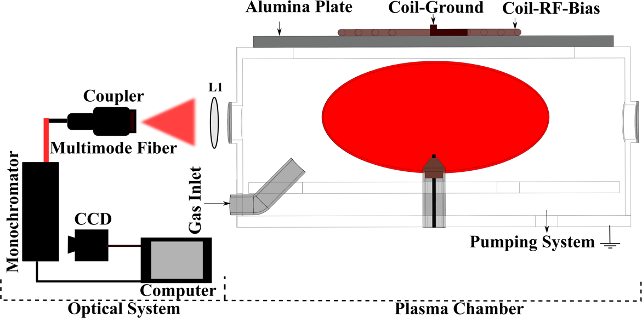
Machine Learning: Data Collection
First Step:
Simultaneously perform and collect 1600 Langmuir Probe and Spectroscopic Measurements
K. Shojaei, et. al., in preparation

Slide 13
Preprocessing, Cleaning, Engineering
Captured emission spectra wavelength range: 300-1000 nm
Used a broadband light source to calibrate the absolute spectra response of the optical system and created a correction file
The baseline offset is subtracted to zero
Correction file is applied, and each spectrum is normalized by the area under the emission spectrum.
The following Ar I line intensities are chose as the input features to ML models. The lines are located at the following wavelengths: 696.57, 706.73, 738.45, 750.42, 751.52, 763.55, 772.44, 794.90, 800.70, 801.57, 810.43, 811.58, 826.49, 840.90, 842.53, 852.21, 912.33, 922.48, 965.80 nm
ML inputs: Batches of 19 dimensional vectors
K. Shojaei, et. al., in preparation

Slide 14
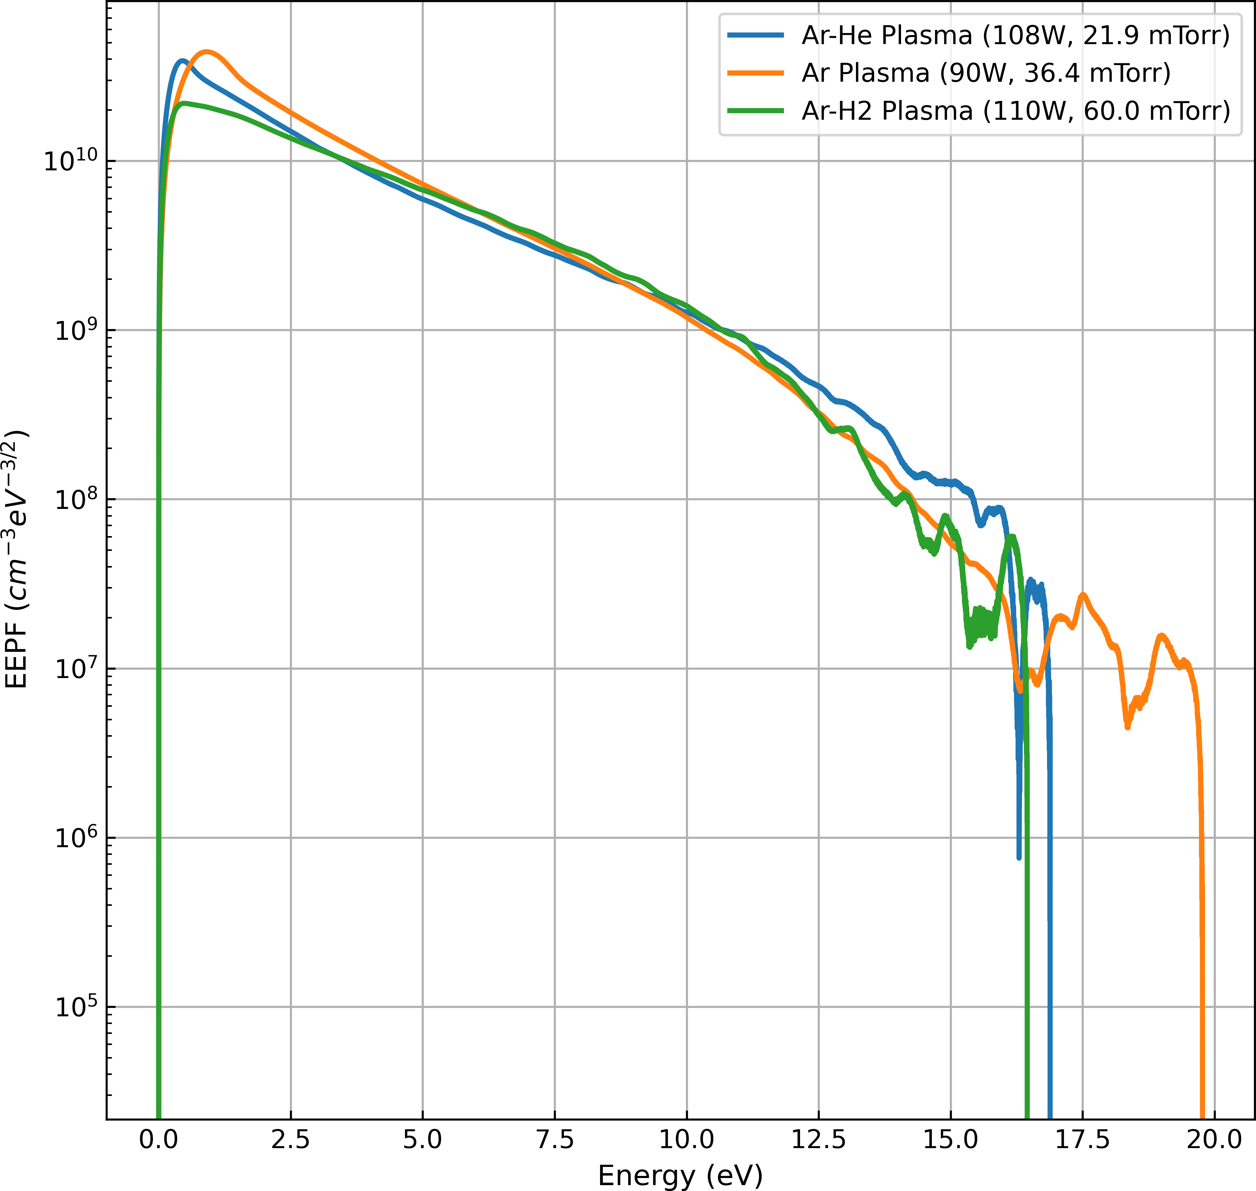
Machine Learning: Preprocessing, Cleaning, Engineering
From Druyvestyn, we are able to directly determine the electron-energy distribution function (EEDF, F(E)) and thus probability function (EEPF, f_{p}(E)), from the second derivative of the probe current.
$$\frac{d^{2}I_{e}}{dV^{2}}=−\frac{e^{2}S_{p}E}{4}\sqrt{\frac{2e}{mV}}f_{p}(E)$$
$$T_{e}=\frac{2}{3}{n_{e}}^{−1}\int_{0}^{∞}{E∗F\left(E\right)dE}$$
Langmuir probe

Slide 15
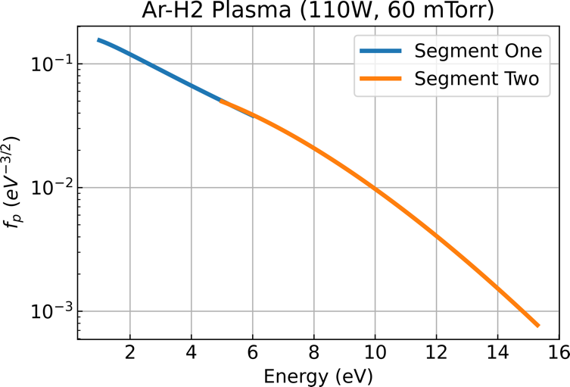
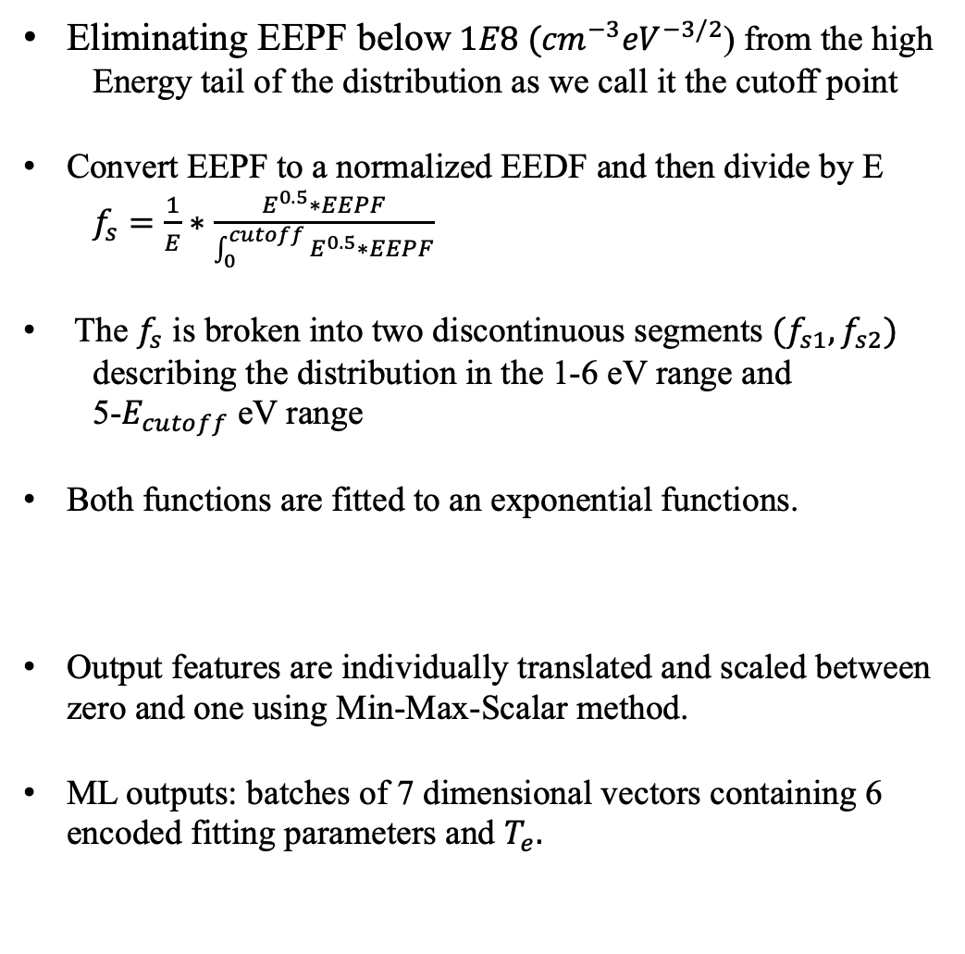
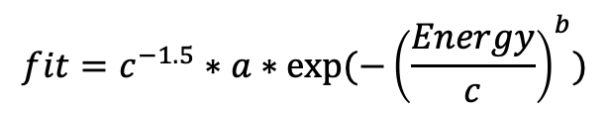
Preprocessing, Cleaning, Engineering
Eliminating EEPF below$1E8 ({cm}^{−3}{eV}^{−3/2}$) from the high
Energy tail of the distribution as we call it the cutoff point
Convert EEPF to a normalized EEDF and then divide by E
$f_{s}=\frac{1}{E}∗\frac{E^{0.5}∗EEPF}{\int_{0}^{cutoff}{E^{0.5}∗EEPF}}$
The $f_{s}$ is broken into two discontinuous segments $(f_{s1},f_{s2})$
describing the distribution in the 1-6 eV range and
5-$E_{cutoff}$ eV range
Both functions are fitted to an exponential functions.
Output features are individually translated and scaled between zero and one using Min-Max-Scalar method.
ML outputs: batches of 7 dimensional vectors containing 6 encoded fitting parameters and $T_{e}.$
$$fit=c^{−1.5}∗a∗exp⁡(−{\left(\frac{Energy}{c}\right)}^{b})$$

Slide 16
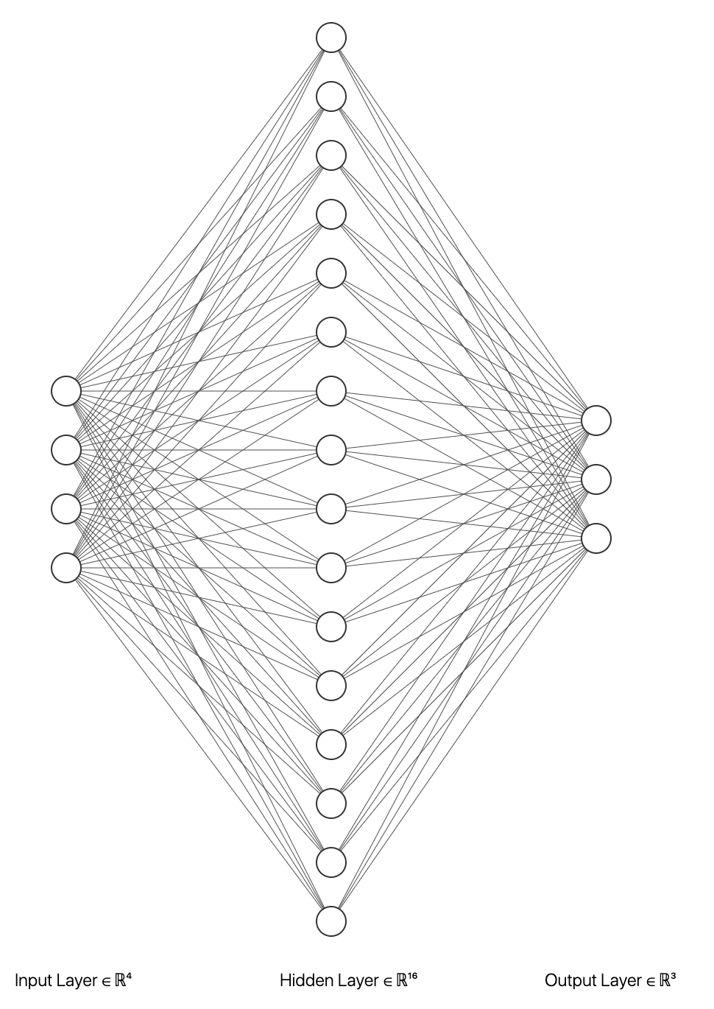
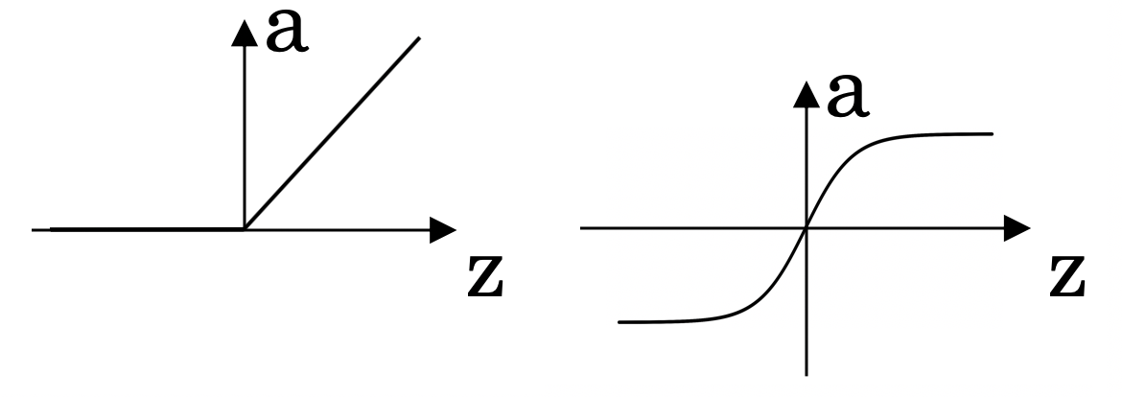
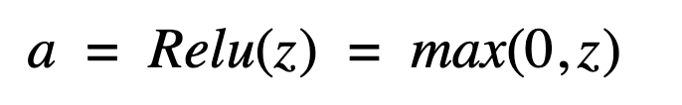
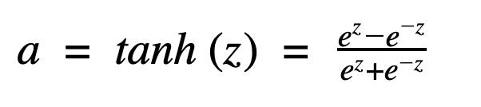
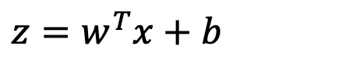

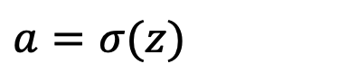
Machine Learning: Deterministic Deep Neural Networks
$$x_{1}$$
$$x_{2}$$
$$σ(z)$$
$$a=\hat{y}$$
$$w^{T}x+b$$
$$z$$
$$a$$
$$x_{3}$$
$$z=w^{T}x+b$$
$$a=σ(z)$$

Slide 17
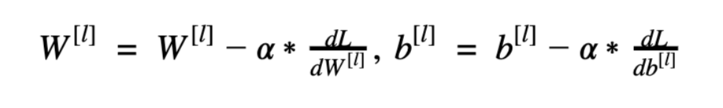
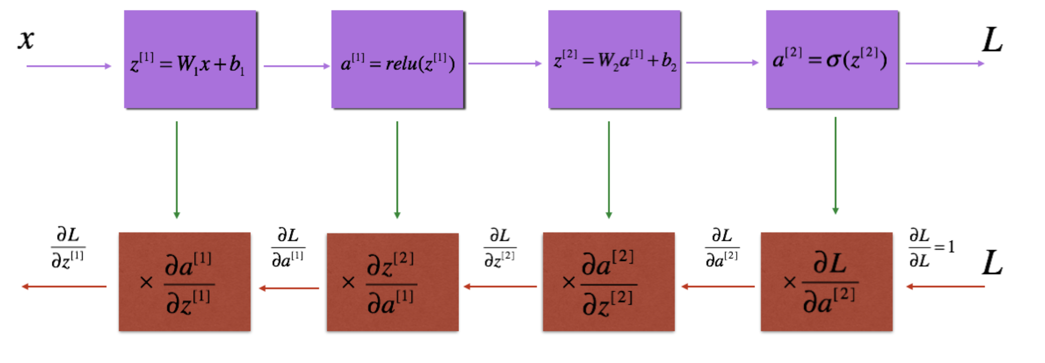
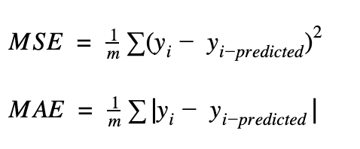
Machine Learning: Deterministic Deep Neural Networks
Gradient Descent:
Forward Propagation Step:
Backward Propagation Step:

Slide 18
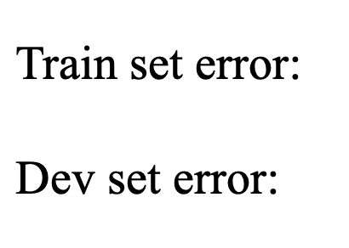
Machine Learning: Deterministic Deep Neural Networks
Train/ Dev/ Test Set: 60% / 20% / 20% Bias and Variance:
1% 15% 15% 0.5%
11% 16% 30% 1.0%
High variance high bias high bias low bias
high variance low variance

Slide 19
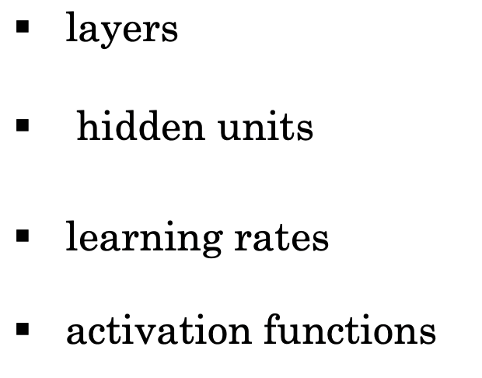
Machine Learning: Deterministic Deep Neural Networks
Applied ML is a highly iterative process:

Slide 20
Machine Learning: Deterministic Deep Neural Networks
Basic recipe for machine learning:
High Bias: 1. more hidden layers and hidden units
2. Train for a longer period
3. Implement advanced optimization algorithms: momentum, RMSprop, and Adam.
High Variance:
1. Implement L2 Regularization
2. Implement Dropout
3. Collect more Data

Slide 21
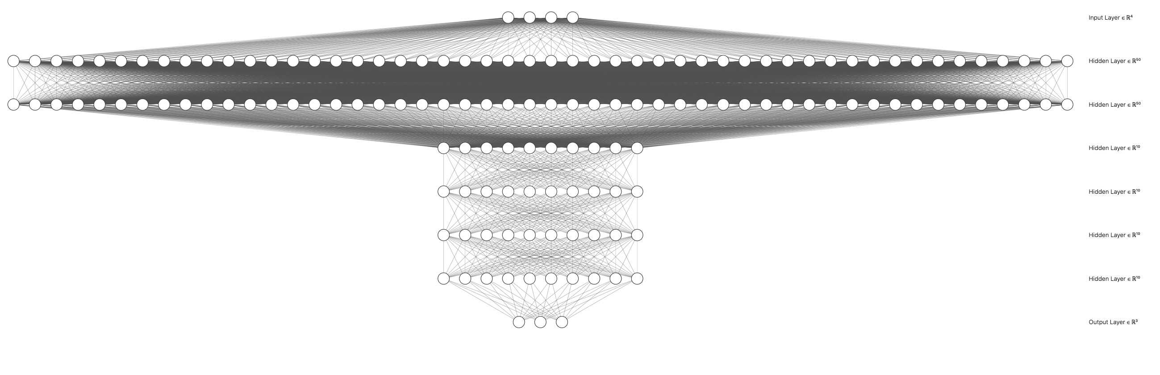
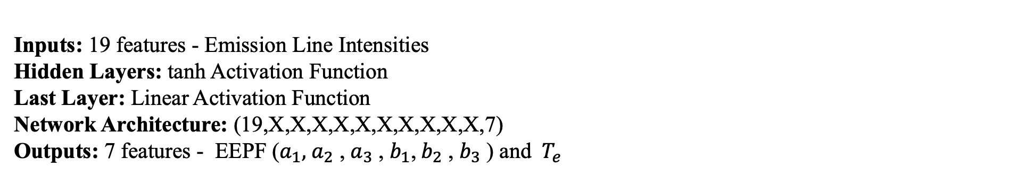
Machine Learning: Deterministic Deep Neural Networks
Deterministic Neural Network:
Inputs: 19 features - Emission Line Intensities
Hidden Layers: tanh Activation Function
Last Layer: Linear Activation Function
Network Architecture: (19,X,X,X,X,X,X,X,X,X,X,7)
Outputs: 7 features - EEPF ($a_{1}, { a}_{2}$ , $a_{3}$ , $b_{1}$,${ b}_{2}$ , $b_{3}$ ) and ${ T}_{e}$

Slide 22
Machine Learning: Probabilistic Deep Neural Networks
Uncertainty:
Aleatoric:
It is simply due to inherent noise in the data.
2. Epistemic:
It comes in play when the dataset is small as model cannot learn effectively especially in regions with no data. This reflects uncertainty in model parameters.
Reduces when more data becomes available.

Slide 23
Machine Learning: Probabilistic Deep Neural Networks
How can we account for aleatoric uncertainty in DNN?
Implement Maximum Likelihood Principle
How can we account for both aleatoric and epistemic uncertainties in DNN?
Implement Bayesian method
Approximate it via Variational Inference and Monte Carlo Dropout techniques

Slide 24
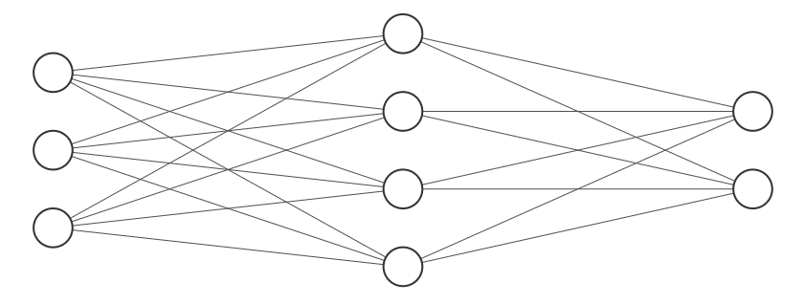
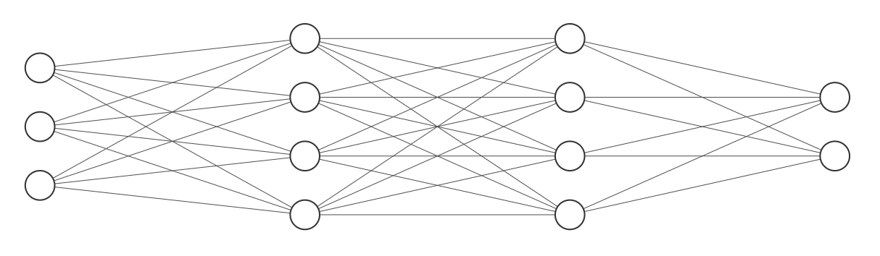
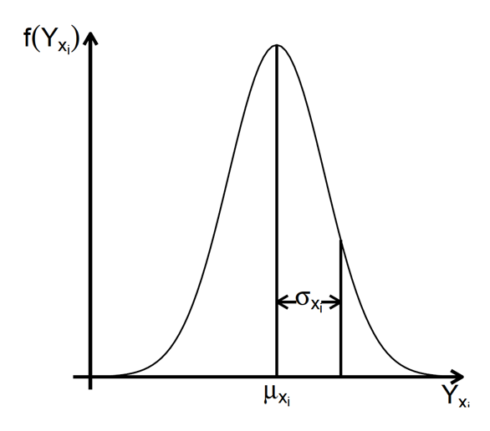
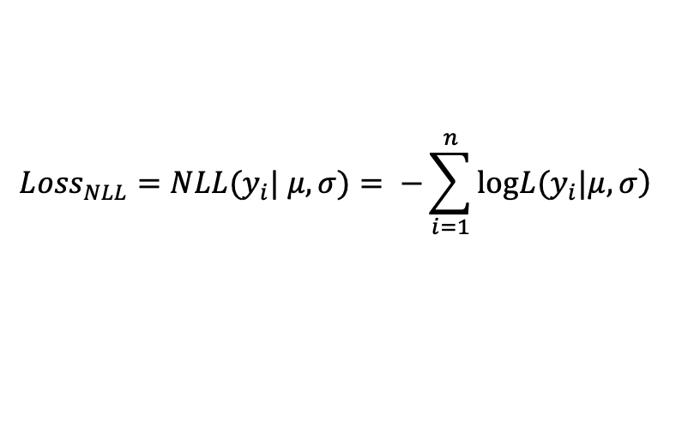
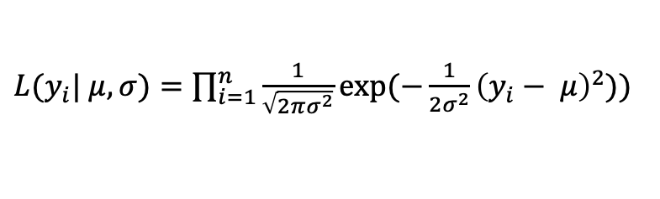
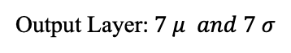
Non-Bayesian Model
Maximum Likelihood Principle:
Deterministic DNN: MSE, MAE
Non-Bayesian DNN: NLL
Input Layer
Hidden Layer
Output Layer: 7
Input Layer
Hidden Layer
Distribution Layer
Output Layer:$7 μ and 7 σ$
Conditional Probability Distribution:
Loss Function:
$L(y_{i}| μ, σ)=\prod_{i=1}^{n}{\frac{1}{\sqrt{2πσ^{2}}}exp⁡(−\frac{1}{2σ^{2}}{\left(y_{i}− μ\right)}^{2}))}$
$${Loss}_{NLL}=NLL(y_{i}| μ, σ)= −\sum_{i=1}^{n}{\log\left.L(y_{i}|μ, σ\right)}$$

Slide 25
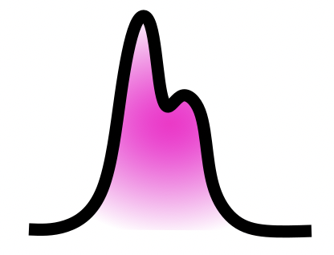

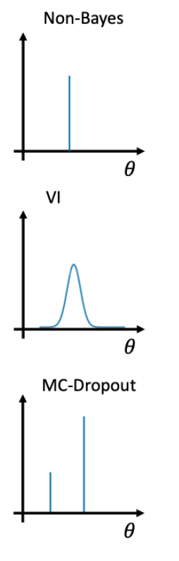
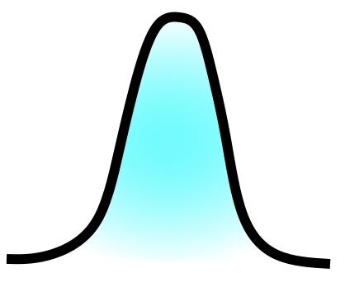
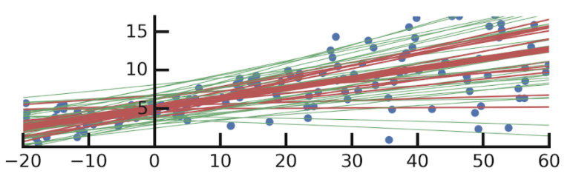
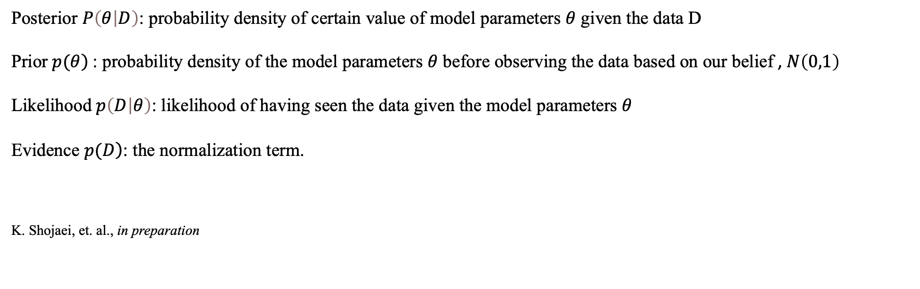
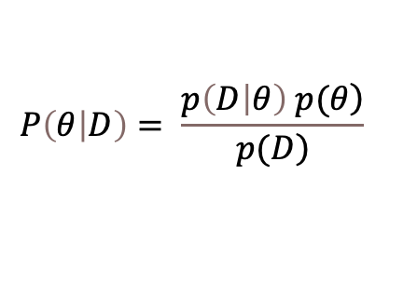
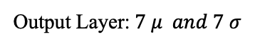
Bayesian Models
Bayesian Neural Networks:
$$P\left(θ | D\right)= \frac{\left.p\left(D | θ\right) p(θ\right)}{\left.p(D\right)}$$
Input Layer
Hidden Layer (2x parameters)
Output Layer:$7 μ and 7 σ$
Distribution Layer
Posterior $P\left(θ | D\right)$: probability density of certain value of model parameters $θ$ given the data D
Prior $\left.p(θ\right)$: probability density of the model parameters $θ$ before observing the data based on our belief , $N\left(0,1\right)$
Likelihood $p\left(D | θ\right)$: likelihood of having seen the data given the model parameters $θ$
Evidence $\left.p(D\right)$: the normalization term.
K. Shojaei, et. al., in preparation

Slide 26
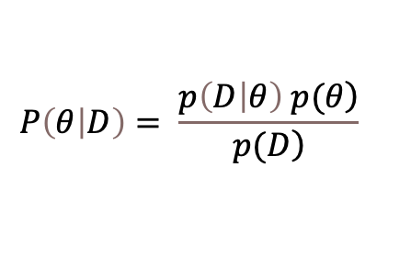
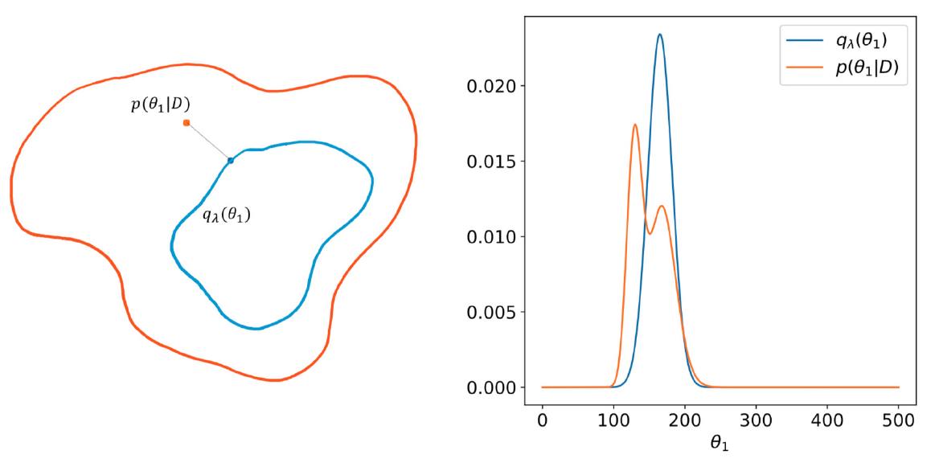
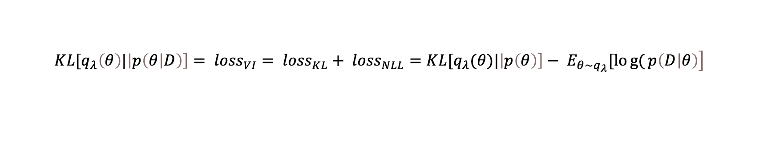
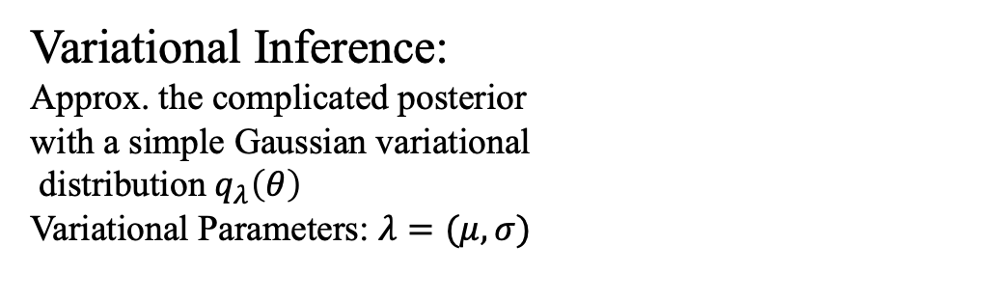
Bayesian Model (Variational Inference)
Bayesian Neural Network::s:
$$P\left(θ | D\right)= \frac{\left.p\left(D | θ\right) p(θ\right)}{\left.p(D\right)}$$
Input Layer
Hidden Layer (2x parameters)
Output Layer:$7 μ and 7 σ$
Distribution Layer
Variational Inference:
Approx. the complicated posterior
with a simple Gaussian variational
distribution$q_{λ}\left(θ\right)$
Variational Parameters: $λ=(μ,σ)$
Kullback-Leibler (KL) Divergence:
$$\left.{KL[q_{λ}\left(θ\right)|\left|p\left(θ | D\right)\right]= loss}_{VI}= {loss}_{KL}+ {loss}_{NLL}=KL[q_{λ}(θ)|\left|p\left(θ\right)\right]− E_{θ\sim q_{λ}}[log{(}p\left(D | θ\right)\right]$$

Slide 27
Machine Learning: Bayesian Model (Variational Inference)
Bayesian Neural Network::s:
$$P\left(θ | D\right)= \frac{\left.p\left(D | θ\right) p(θ\right)}{\left.p(D\right)}$$
Input Layer
Hidden Layer (2x parameters)
Output Layer:$7 μ and 7 σ$
Distribution Layer
Variational Inference:
Variational Parameters: $λ=(μ,σ)$
Kullback-Leibler (KL) Divergence:
$$\left.{KL[q_{λ}\left(θ\right)|\left|p\left(θ | D\right)\right]= loss}_{VI}= {loss}_{KL}+ {loss}_{NLL}=KL[q_{λ}(θ)|\left|p\left(θ\right)\right]− E_{θ\sim q_{λ}}[log{(}p\left(D | θ\right)\right]$$
$$\left.{loss}_{KL}=KL[N(μ,σ)|\left|N\left(0,1\right)\right]= −\frac{1}{2}(1+\log\left(σ^{2}\right)− μ^{2}−σ^{2}\right)$$
Layer Wise
$${loss}_{NLL}$$
At the end of the forward pass
$ε$ ~ $N(0,1)$
Re-parametrization trick and Flipout methods are used in the backpropagation step. $θ_{rep}=\left(a_{rep}=μ_{a}+σ_{a}.ε,c_{rep}=μ_{c}+σ_{c}.ε\right)$

Slide 28

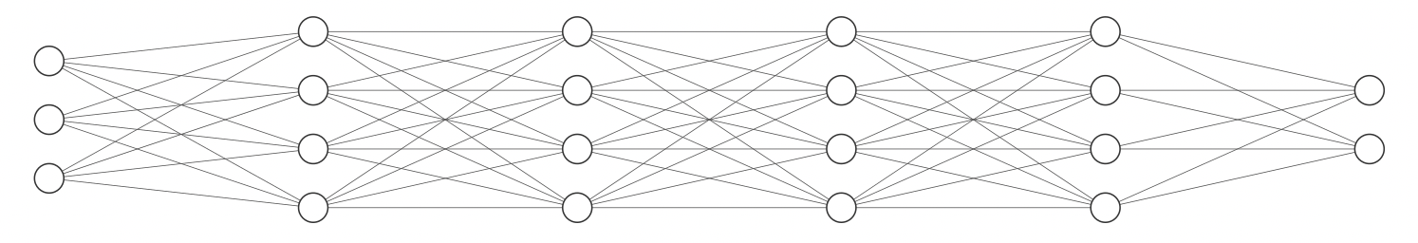

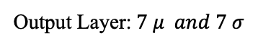
Bayesian Model (Monte Carlo Dropout)
Bayesian Neural Networks:
Hidden Layer
(2x parameters)
Hidden Layer
(2x parameters)
Hidden Layer
(2x parameters)
Input Layer
Output Layer:$7 μ and 7 σ$
Distribution Layer

Slide 29


Bayesian Model (Monte Carlo Dropout)
Bayesian Neural Networks:
Loss Function:
$L(y_{i}| μ, σ)=\prod_{i=1}^{n}{\frac{1}{\sqrt{2πσ^{2}}}exp⁡(−\frac{1}{2σ^{2}}{\left(y_{i}− μ\right)}^{2}))}$
$${Loss}_{NLL}=NLL(y_{i}| μ, σ)= −\sum_{i=1}^{n}{\log\left.L(y_{i}|μ, σ\right)}$$
Hidden Layer
(2x parameters)
Hidden Layer
(2x parameters)
Hidden Layer
(2x parameters)
Input Layer
Output Layer:$7 μ and 7 σ$
Distribution Layer

Slide 30

Probabilistic Deep Neural Networks
Probabilistic Deep Neural Networks Architectures:
1. Non-Bayesian DNN:
Activation function: all hyperbolic tangent functions, A
Dense layers: (19, 50, 50, 50, 50, 50, 50, 30, 30, 20, 14, Gaussian distribution layer) (9 hidden layers)
$α_{0}={10}^{−3}$, $N_{t}$ = 10,000 epochs , $α= α_{0}∗{\left(1−4.15∗\frac{t}{N_{t}}\right)}^{0.75}$ ,
Adam optimization algorithm: $β_{1}$ and $β_{2}=$ 0.9 and 0.999
2. Bayesian DNN approximated via Variational Inference technique:
Activation function: all hyperbolic tangent functions
Dense Flipout/Re-parameterization layers: (19,60,50,30,30,30,30,14, gaussian distribution layer) (6 hidden layers)
$α$= ${4∗10}^{−4}$ , $N_{t}$ = 10,000 epochs, Adam optimization algorithm: $β_{1}$ and $β_{2}=$ 0.9 and 0.999
3. Bayesian DNN approximated via Monte Carlo Dropout method:
Activation function: all hyperbolic tangent functions
Dense layers: (19, 300, 300, 300, 300, 200, 200, 200, 200, 200, 200, 14, exponential distribution layer) (10 hidden layers)
One dropout layer in between and after the last 200 nodes layer.
Dropout Rate: 10% , $α$= ${2∗10}^{−4}$ , $N_{t}$ = 25,000 epochs, Adam optimization algorithm: $β_{1}$ and $β_{2}=$ 0.9 and 0.999
K. Shojaei, et. al., in preparation

Slide 31


Probabilistic Deep Neural Networks
Metrics used to Analyze the performance of networks:
Coefficient of Determination ($R^{2}$) and Mean Absolute Percentage Difference (MAPE)
 | Model
R2 Score: | Non-Bayes | Bayes (MCD) | Bayes (VI)
a | 0.73 | 0.86 | 0.85
b | 0.74 | 0.82 | 0.78
c | 0.74 | 0.77 | 0.79
d | 0.76 | 0.87 | 0.87
e | 0.89 | 0.89 | 0.89
g | 0.92 | 0.95 | 0.94
$$T_{e}$$ | 0.96 | 0.96 | 0.94
K. Shojaei, et. al., in preparation

Slide 32



Probabilistic Deep Neural Networks
Predicting with an input similar to the data models were trained on.
Ran 500 times and sampled from the predicted Gaussian distributions for each model.
All the 500 predictions are summarized by a mean and the 95%prediction interval.
K. Shojaei, et. al., in preparation

Slide 33



Probabilistic Deep Neural Networks
Predicting with an input dissimilar to the data models were trained on.
Ran 500 times and sampled from the predicted Gaussian distributions for each model.
All the 500 predictions are summarized by a mean and the 95%prediction interval.
K. Shojaei, et. al., in preparation

Slide 34
Conclusion
Developed a Langmuir probe and Spectroscopy setup to simultaneously perform measurements and automated data processing to monitor the quality of measurements in real time
Developed and implemented a non-Bayesian and 2 Bayesian deep neural networks in TensorFlow to make inference of plasma properties from plasma emission spectra.

